Slide 1

US Colleges Analysis
Individual Report – aa2569

Slide 2
Hypotheses
More students prefer Public universities over Private universities.
The costs associated with Public universities are less compared to Private universities.
Public universities have better acceptance rates compared to Private universities.
The differentiation between Public and Private institutes can be classified using Multivariate Analysis Techniques.

Slide 3
Questions
Investigate the relationships between the universities based on given variables using Principal Component Analysis. Do we find any relations, and can we analyse if there is any difference between the Private and Public Universities?
Carry out cluster analysis to study the relationship between the universities and find out if there are any reasons behind the clustering. Is the clustering done based on the type of university or something different?
Identify the critical factors underlying the observed variables and examine the relationships between the universities for these factors. Check if the factors help us classify the type of university (Public/Private)
Using regression, can we predict the acceptance rate of the universities based on all the factors provided for the universities? Which regression technique works best for this?

Slide 4
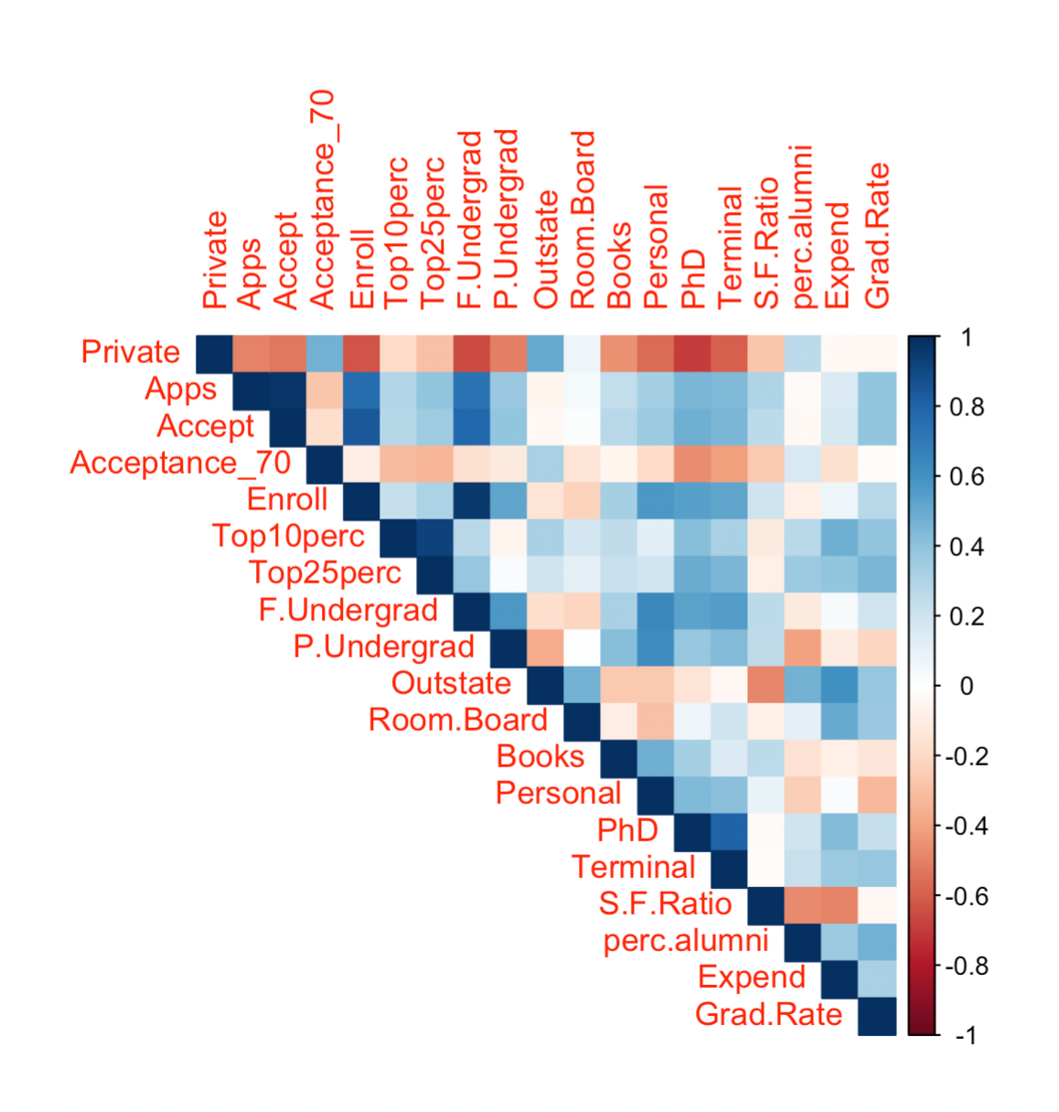
PCA
There is a correlation.
So, we use PCA.

Slide 5
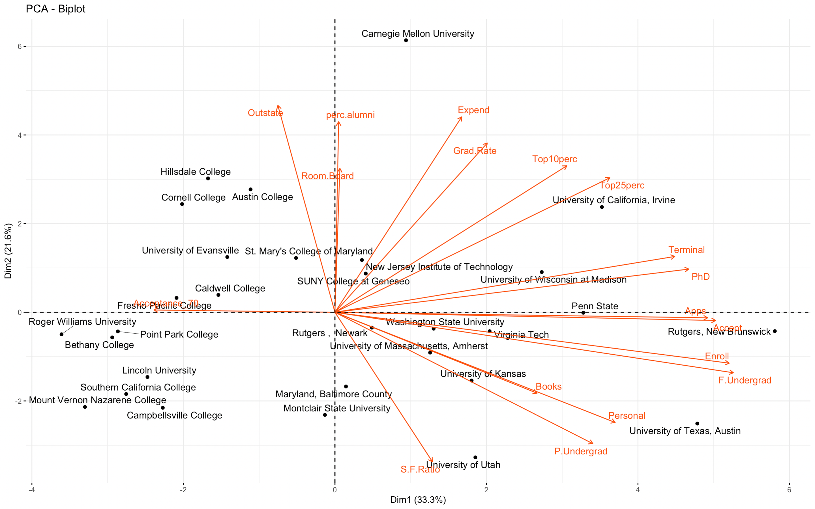

Slide 6
PCA Inferences
The Principal component analysis has classified all the public universities to the right side of the Y axis and all the private ones to the left.
Yes, we can classify the type of university based on the principal component analysis.
We can also see that the number of applications, acceptances, and enrollments is more for Public universities, as per our hypothesis.
But, contradicting our hypothesis, the costs incurred by students are more for Public universities compared to private ones.

Slide 7
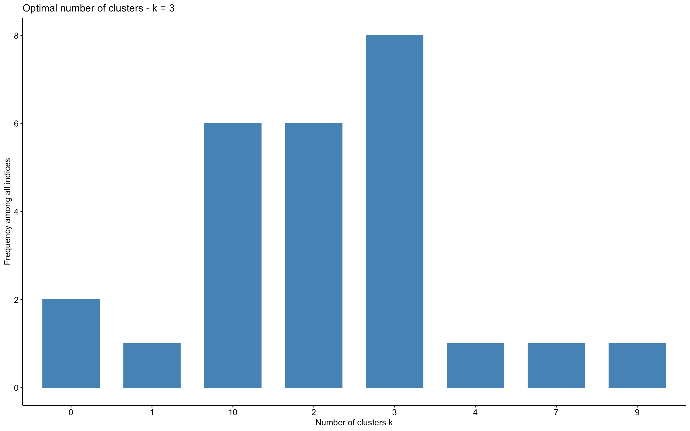
Clustering

Slide 8
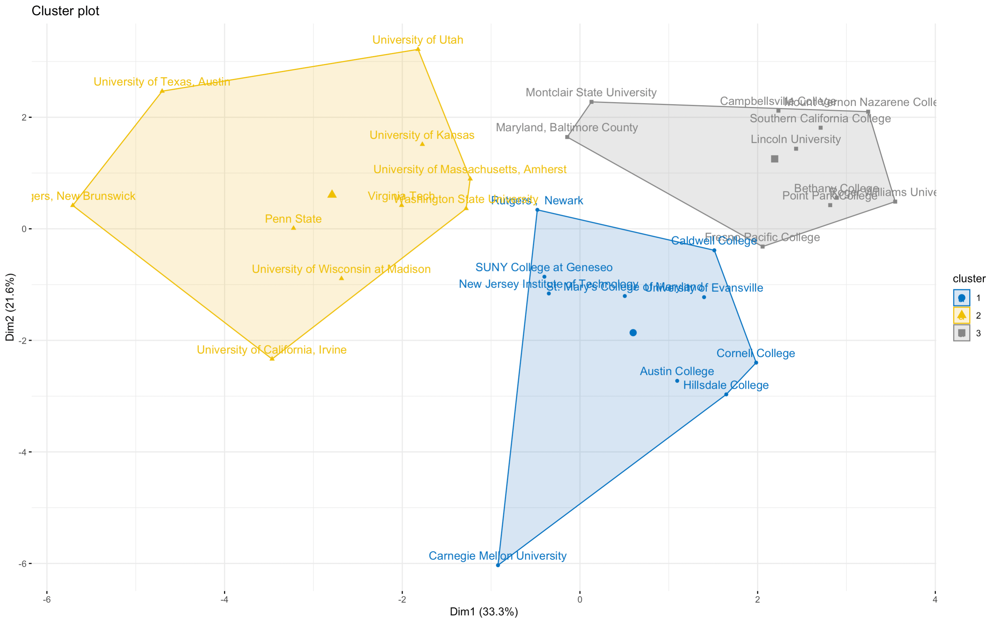
Clusters
Next we check by eliminating correlation

Slide 9
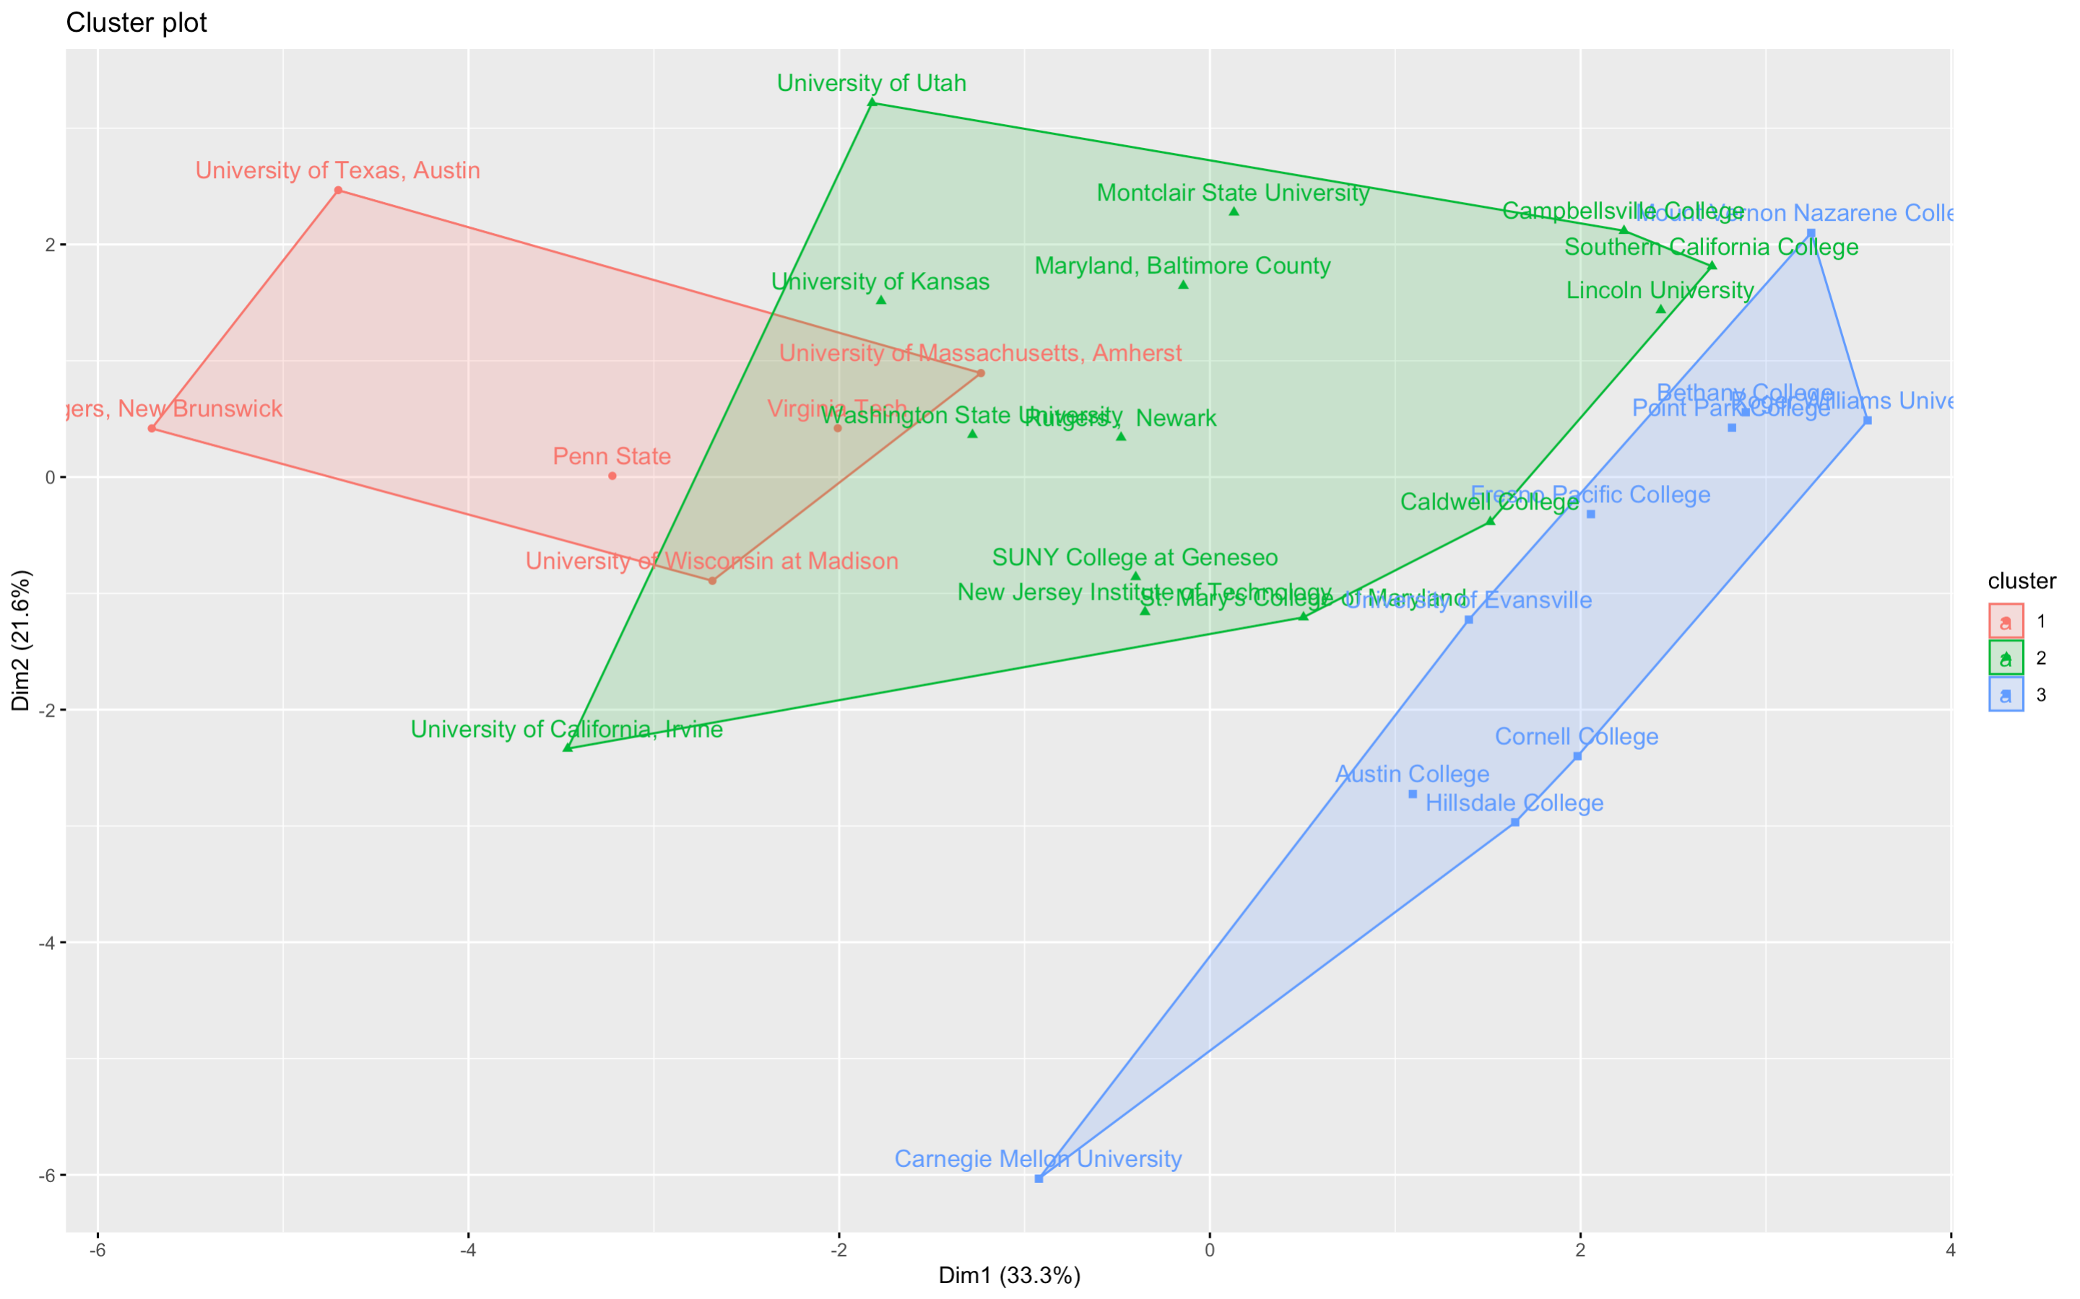
Clusters after scaling

Slide 10
Cluster Analysis Inferences
We observe that all the universities in Cluster 3 (blue) are Private universities.
Except two of the Private universities rest, all fell under Cluster 3.
The Public Universities are placed in the remaining two clusters.
The ones in Cluster 1 (Red) have many applications, acceptances and enrollments (in
thousands).
Cluster 2 (green) is also of Public universities but the ones with fewer applications,
acceptances, and enrollments (in hundreds).

Slide 11
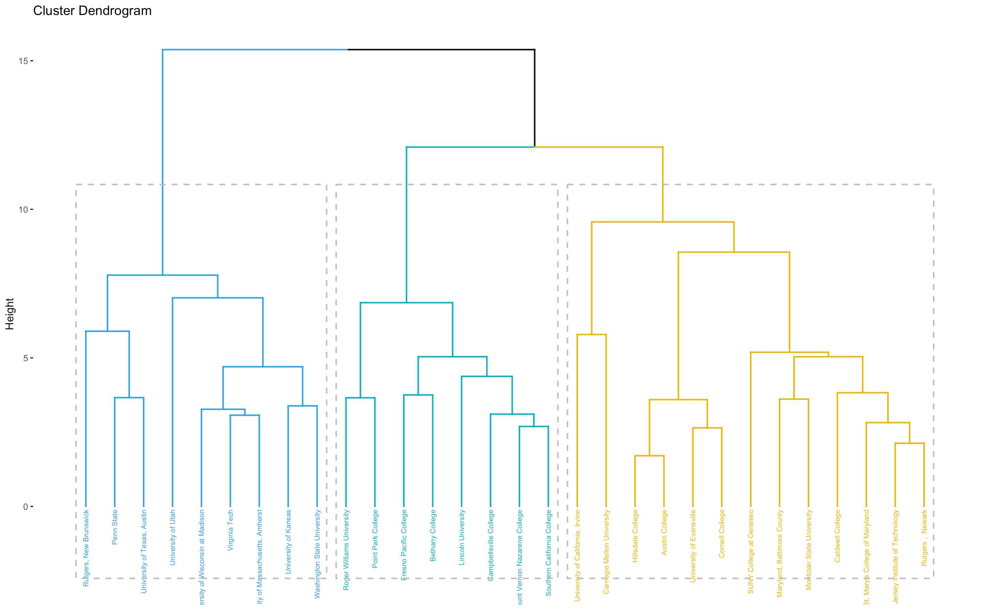
Dendogram

Slide 12
Cluster Analysis Inferences
In this clustering, all the universities in teal colour are Private universities.
The universities in Blue are all Public, and the ones in the Yellow cluster are a mixture of
public and private universities.
Even using this method, we can somewhat differentiate between public and private.
The Blue and Yellow differentiation mostly focuses on the number of applications, acceptances, and enrollments. The ones in blue have much higher numbers when compared to the ones in yellow.

Slide 13
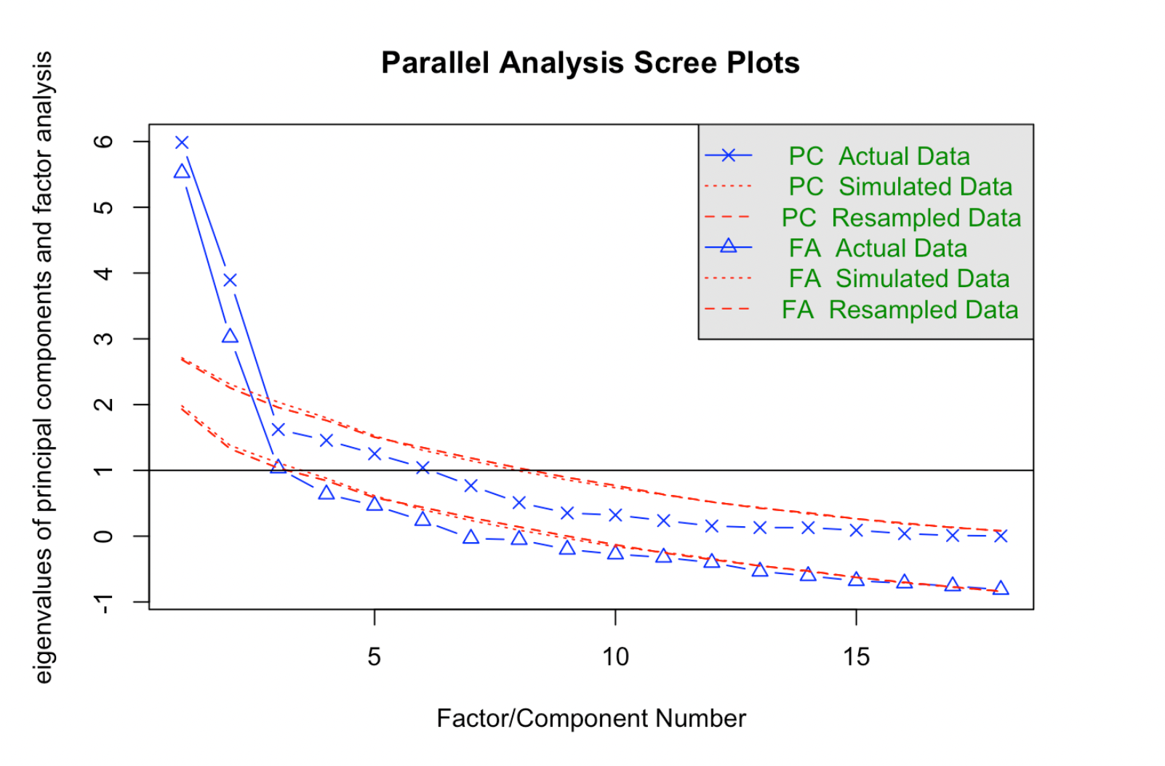
EFA
Optimal factors - 3

Slide 14
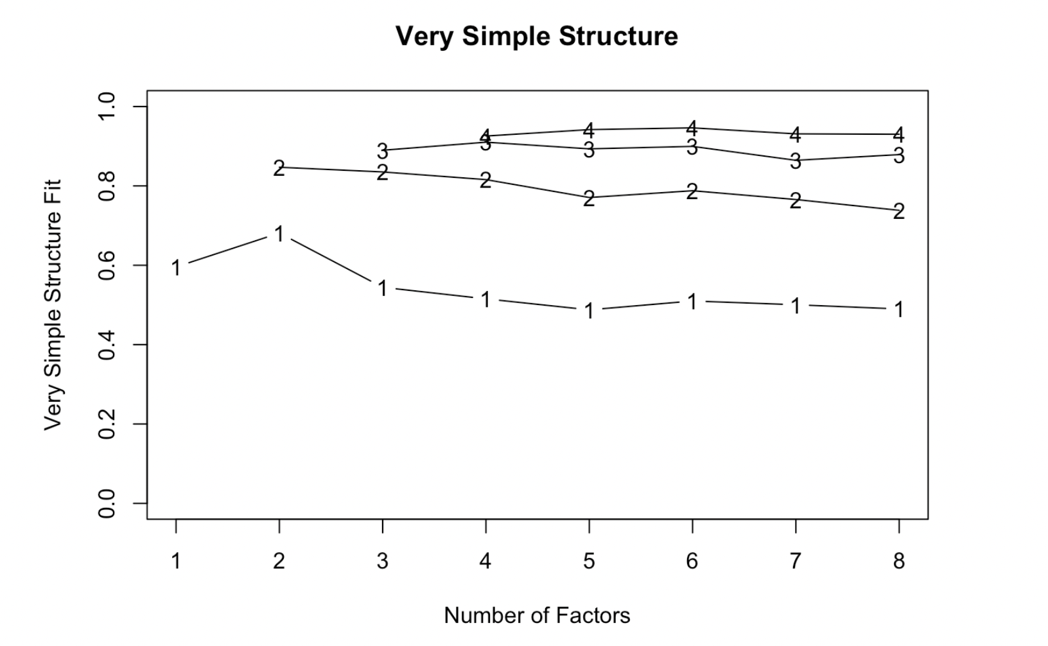
Optimal Factors

Slide 15
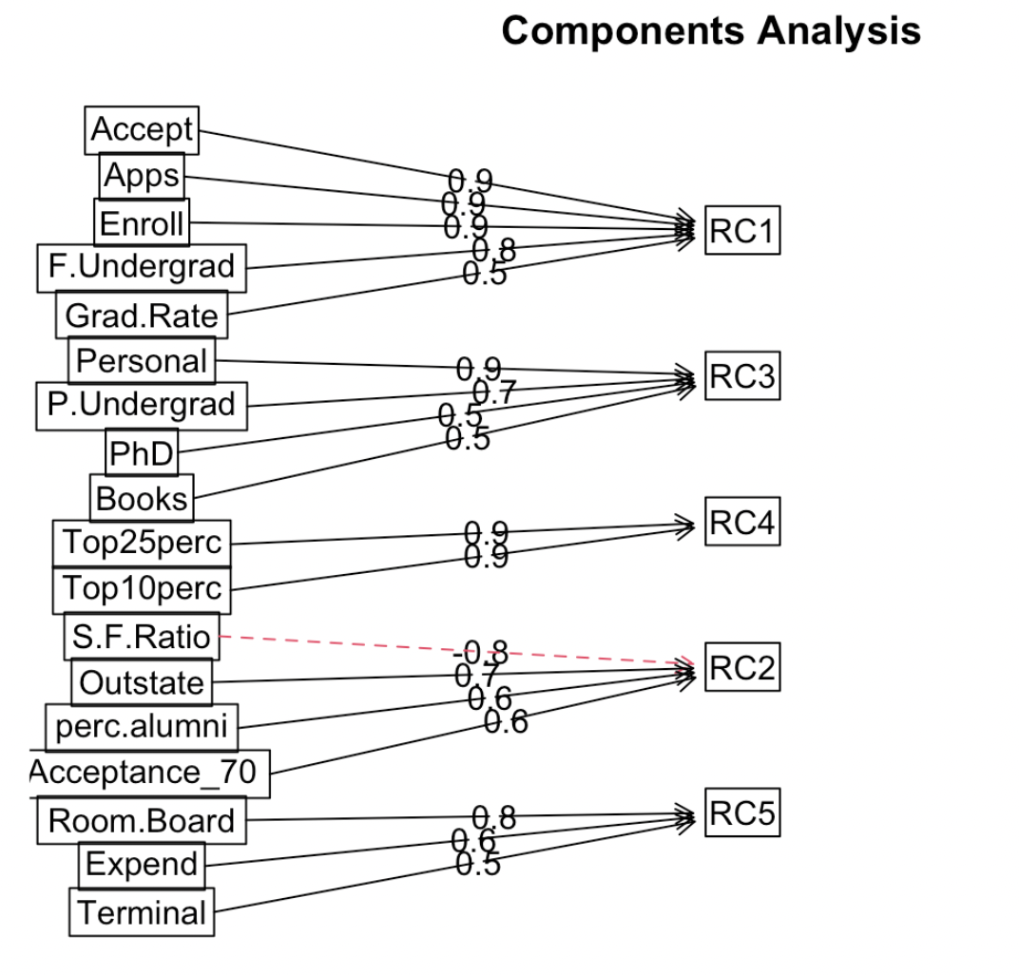
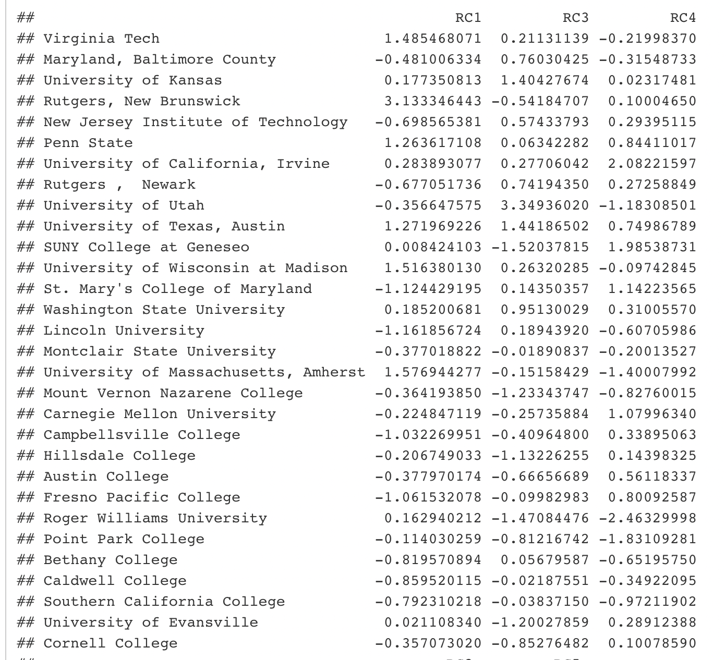

Slide 16
EFA Inferences
The diagram shows that Applications, Acceptances, Enrollments, and Graduation rates come under RC1.
This can be validated because all public universities had positive RC1, the exact inference we got in the PCA.
The private column showed a strong negative value with RC4. It can be recollected that all Private colleges had negative RC4.
Books and Personal expenses are related to RC3.
This shows that even using EFA, we can classify between Public and Private universities.

Slide 17
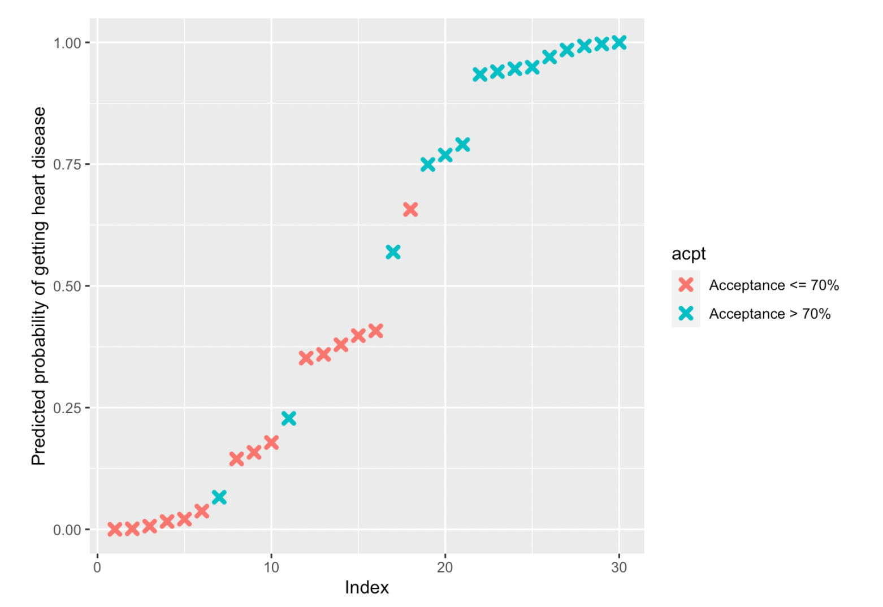
Logistic Regression

Slide 18
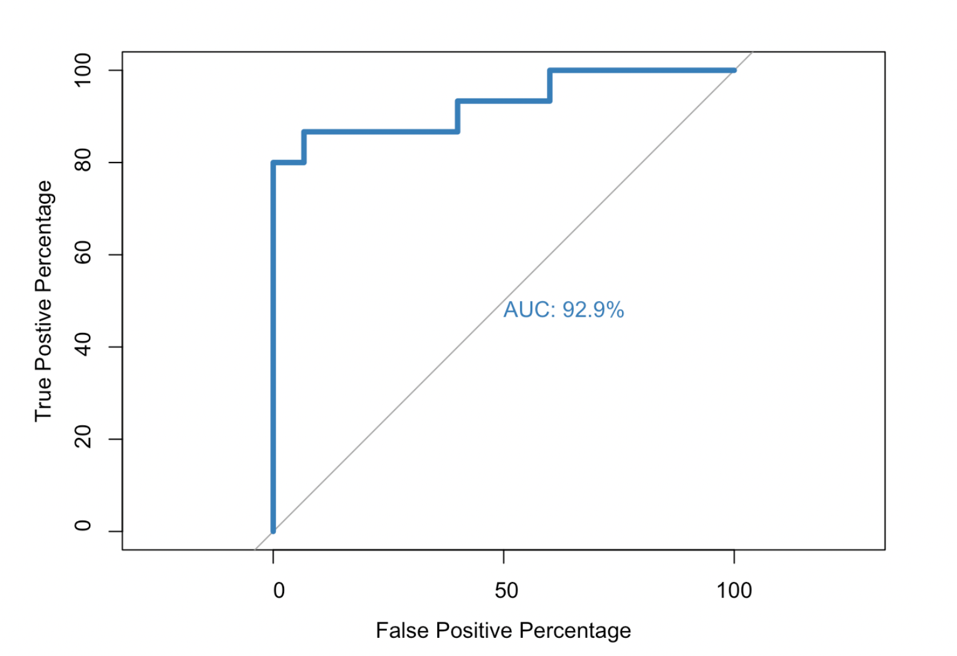
ROC Curve

Slide 19
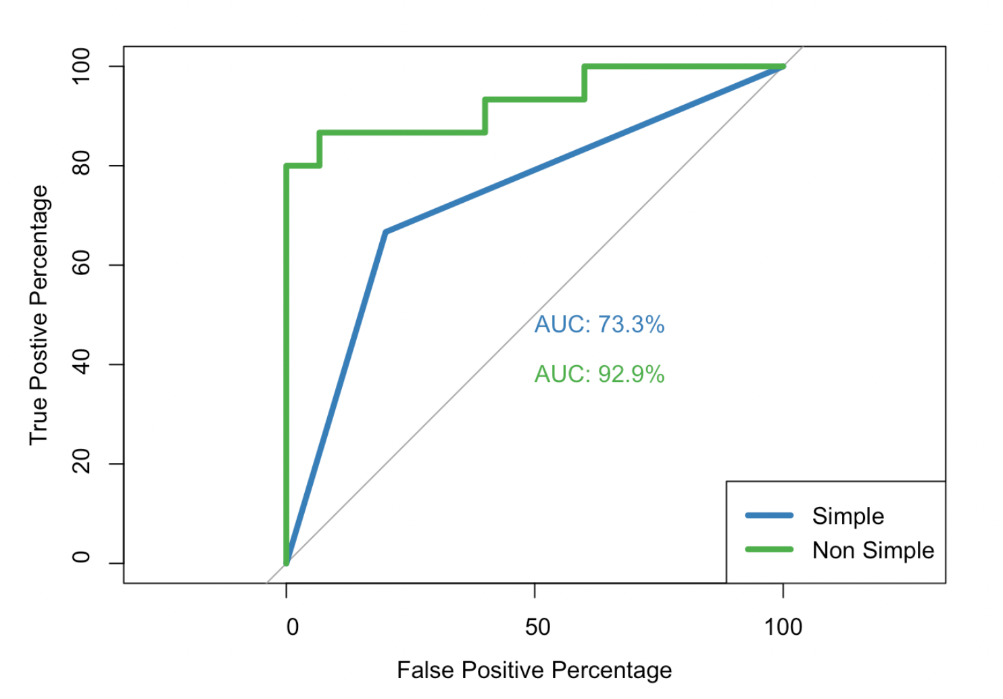
ROC Curve comparisons

Slide 20
Logistic Regression Inferences
The analysis shows that the Acceptance rate greater or less than 70% can be predicted using the college dataset variables.
We have seen a 92.9% area under the curve which states the results are very good.
And we prefer Logistics Regression, as the variable factors are only two greater or less than 70%.

Slide 21
Summary - Hypotheses
More students prefer Public universities over Private universities.
Yes, the hypothesis is correct.
2. The costs associated with Public universities are less compared to Private universities.
No, the hypothesis is proved wrong
3. Public universities have better acceptance rates compared to Private universities.
Yes, the hypothesis is correct.
4. The differentiation between Public and Private institutes can be classified using Multivariate Analysis techniques. Yes, the hypothesis is correct.

Slide 22
Summary – Question 1
Investigate the relationships between the universities based on given variables using Principal Component Analysis. Do we find any relations, and can we analyse if there is any difference between the Private and Public Universities?
Yes, we found the differences and were able to validate our hypothesis. And, we were able to differentiate between Public and Private universities.

Slide 23
Summary – Question 2
Carry out cluster analysis to study the relationship between the universities and find out if there are any reasons behind the clustering. Is the clustering done based on the type of university or something different?

Slide 24
Summary – Question 3
Identify the important factors underlying the observed variables and examine the relationships between the universities for these factors. Check if the factors help us classify the type of university (Public/Private)
Important factors were identified, and we could classify Public and Private Universities.

Slide 25
Summary – Question 4
Using regression, can we predict the acceptance rate of the universities based on all the factors provided for the universities? Which regression technique works best for this?
Yes, we were able to predict. Logistic Regression works best in this case.

Slide 26
Thank You
Any Suggestions?

